Slide 1

Booze Share – An Innovation, On The Rocks

Slide 2
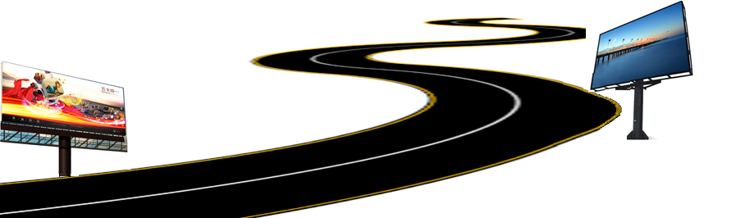
Executive Summary
The objective of this presentation is to propose building a national infrastructure of mass communication, provisioned via network of LED wall based point of displays (POD), installed across pan-India roadway toll station.
Through the course of this presentation, we aspire to demonstrate how the best in class & multi-purpose visual media displays would provide a variety of flexible benefits to NHAI and our project detail for successful execution.

Slide 3

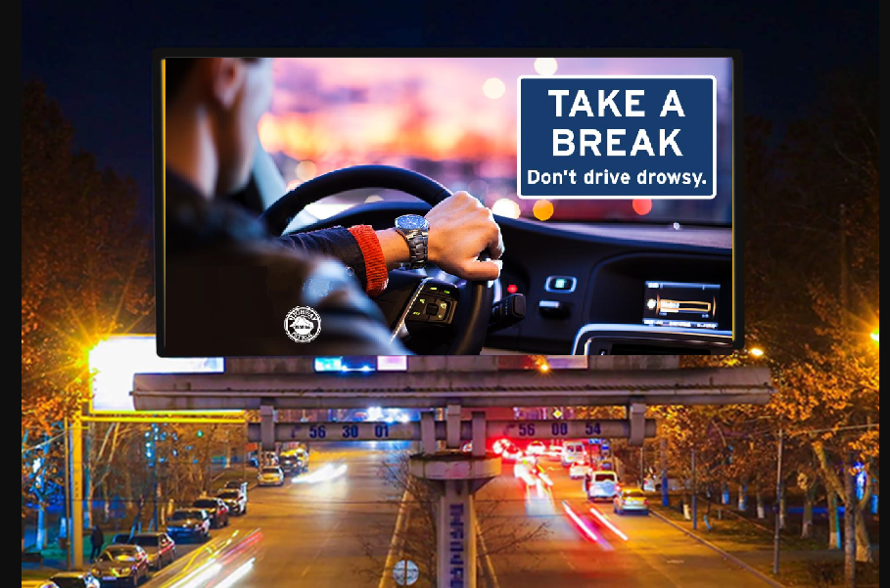
Body of Work
Installation of 18x12ft LED Point of Displays (POD) at Toll stations on national roads, including expressways, national & state highways and intra-city roadways.
All existing 550+ Toll stations to be equipped with the PODs, with additional flexibility to promptly install screens on new/under-development toll stations.
POD will be designed to play video streams, motion pictures, still images & scrolling text and will be installed on top of 18-20 feet high platform, for clear visibility upto 150 meters.
All PODs will be centrally managed from a control room, with recovery systems for business continuity during any unplanned outages.

Slide 4
Details of Hardware
Bigger column diameter - 200 mm, Smaller column diameter - 150 mm
Both columns will be connected by flanges
Final column will be mounted on concrete base by anchor bolts
Column will be supported by two C-channel from opposite sides to cater for wind load
C- channel frame will be mounted on top of column to support digital board
3 column supports are required for 12ft x 18ft advertising board
Oil & Radium painted surface finish (All seasons + night vision + lifespan 10 years)
Artefact | Period
Fabrication | 2 Days
Installation | 1 Day
Foundation | 4 Days
Phase 1 implementation (150 locations) | < 100 Days

Slide 5
Installation of Hardware and Software
LED Grid display will be integrated with a controller which will be attached to a processor which will run the software for the content of desired choice.
Processor will have a internet connectivity which will upload the content to the desired location, content will be software driven.
Software will have the ability to change the content from the control room. It will have flexibility to dynamically display the content automatically, during required timings.
Content will be designed in such a way that the commuter will be able to view it from a distance of about 150 meters.
Power backup can be provided by diesel generator & surpassed with UPS of correct wattage.
Bespoke software to run on all stand alone systems powered through a powerful quad core processor to play media.
Software WILL be remotely operated on for individual machines or mobile applications and will be broadcasted to all PODs across India through internet connectivity.

Slide 6
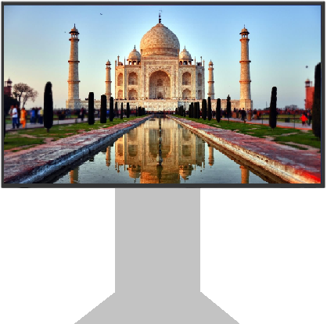


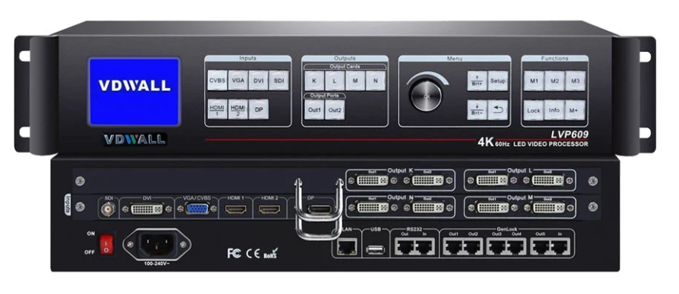
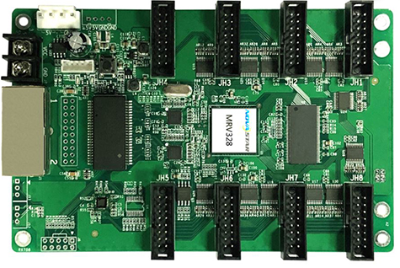
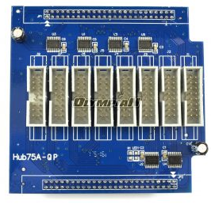
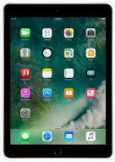
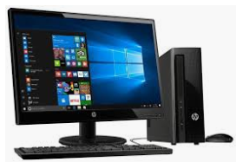
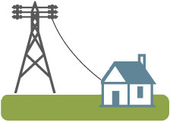
End to End Infrastructure
POD
Video Processor &
Application Software
Receiving
Card
Sending
Card
Control System
Power Distribution

Slide 7





Value Proposition
Mass communication
Instrument, with daily reach to about 5 crore travelers
Broadcast in local language, allowing communication to reach wide range of audience
Emergency communications
can be displayed for public awareness in extreme incidents like natural disaster, fire, accidents etc.
Location specific broadcast
allowing most relevant communication to reach local residents
10% time allotment to NHAI of the transmission time for dedicated road safety & traffic management
Immediate broadcast
of message across media channels like video, image, text etc.

Slide 8
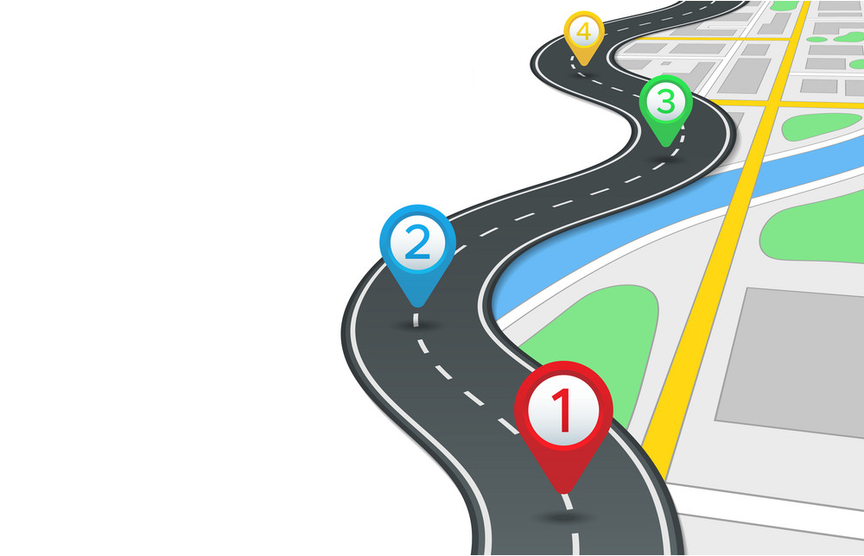
Project Plan & Duration
4
Phase 3: 12 months
POD installation on final 200 locations
Beta Testing & Handover – Q2 2022
AMC commencement
3
Phase 2: 12 months
POD installation at 150 locations
Beta Testing – Q1 2022
2
Phase 1: 12 months
POD installation at 150 locations
Beta Testing – Q1 2021
1
Project Approval and Commencement
Q1 2020

Slide 9
Project Phase Financials
2022
Return Of Investment 2022-23

Slide 10
NHAI Support
To accelerate implementation of this program, a support model is also requested NHAI, as:
POD installation space at all national Toll Plazas
POD installation space next to Toll Ahead sign boards
Space on over-bridges, for possible future extension of PODs
20KVA electricity supply line (to be paid for & maintained by project team)
POD & electricity line access to AMC contract vendor for maintenance purposes

Slide 11
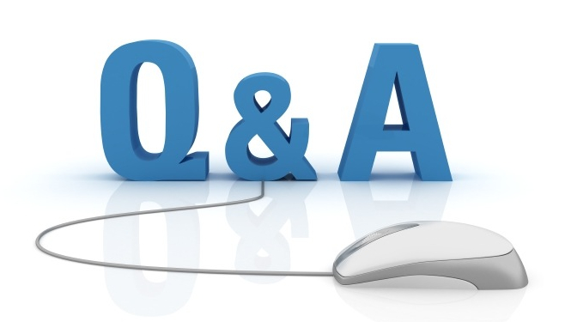
Q & A

